Slide 1
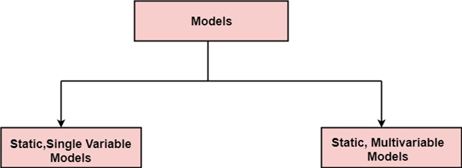
LECTURE-10 STATIC, SINGLE AND MULTIVARIATE MODELS
A model may be static or dynamic. In a static model, a single variable is taken as a key element for calculating cost and time. In a dynamic model, all variable are interdependent, and there is no basic variable.

Slide 2
Static, Single Variable Models:
When a model makes use of single variables to calculate desired values such as cost, time, efforts, etc. is said to be a single variable model. the most common equation is:
C=aL^{b}
Where C = Costs
L= size
a & b are constants
The software engineering laboratory established a model called sel model, for estimating its software production. this model is an example of the static, single variable model.

Slide 4
Static, Multivariable Models:
These models are based on method 1, they depend on several variables describing various aspects of the software development environment. In some model, several variables are needed to describe the software development process, and selected equation combined these variables to give the estimate of time & cost. these models are called multivariable models.
Walston and Felix develop the models at IBM provide the following equation gives a relationship between lines of source code and effort:

Slide 5
QUESTIONS:
Q.1 Compare the Walston-Felix Model with the SEL model on a software development expected to involve 8 person-years of effort.
1. Calculate the number of lines of source code that can be produced.
2. Calculate the duration of the development.
3. Calculate the productivity in LOC/PY
4. Calculate the average manning

Slide 6
SOLUTION :

Slide 7
Q.2 What is static single variable models ?
Q.3 What is static multivariable models?
Q.4 What is the difference between static single variable models & static multivariable models?
Q.5 Write the equation used in both the models ?

